Slide 1
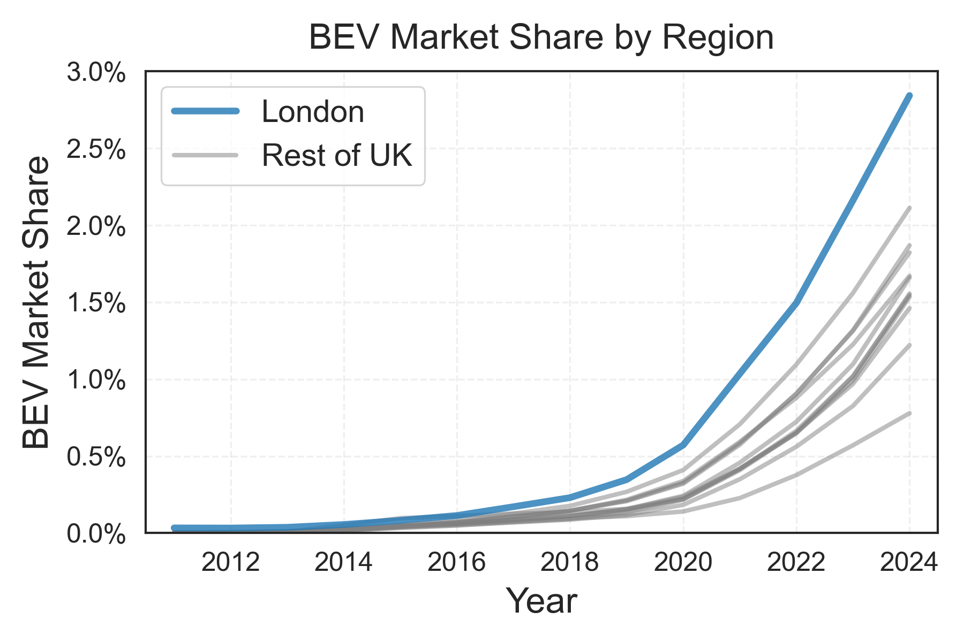
Visualising London’s Future Public EV Charging Needs
Dr Isaac Flower
22nd September 2025
Battery Electric Vehicle
London has the UK’s highest share of BEVs.
More EVs → Higher energy demand → greater planning needs.
Local Authorities must coordinate charging infrastructure rollout.
Network Operators must support connections and security of supply.
Source: Department for Transport

Slide 2
EV Adoption Growth in London Boroughs
High EV Adoption in Westminster, Camden, City of London, & Kensington and Chelsea.
Factors affecting high EV adoption:
Affluence
Congestion charge exemption
Charging availability
Future charging demand not evenly distributed.
Targeted planning required.
Sources: Office for National Statistics (Spatial Boundaries)
Department for Transport (Vehicle Registrations)

Slide 3
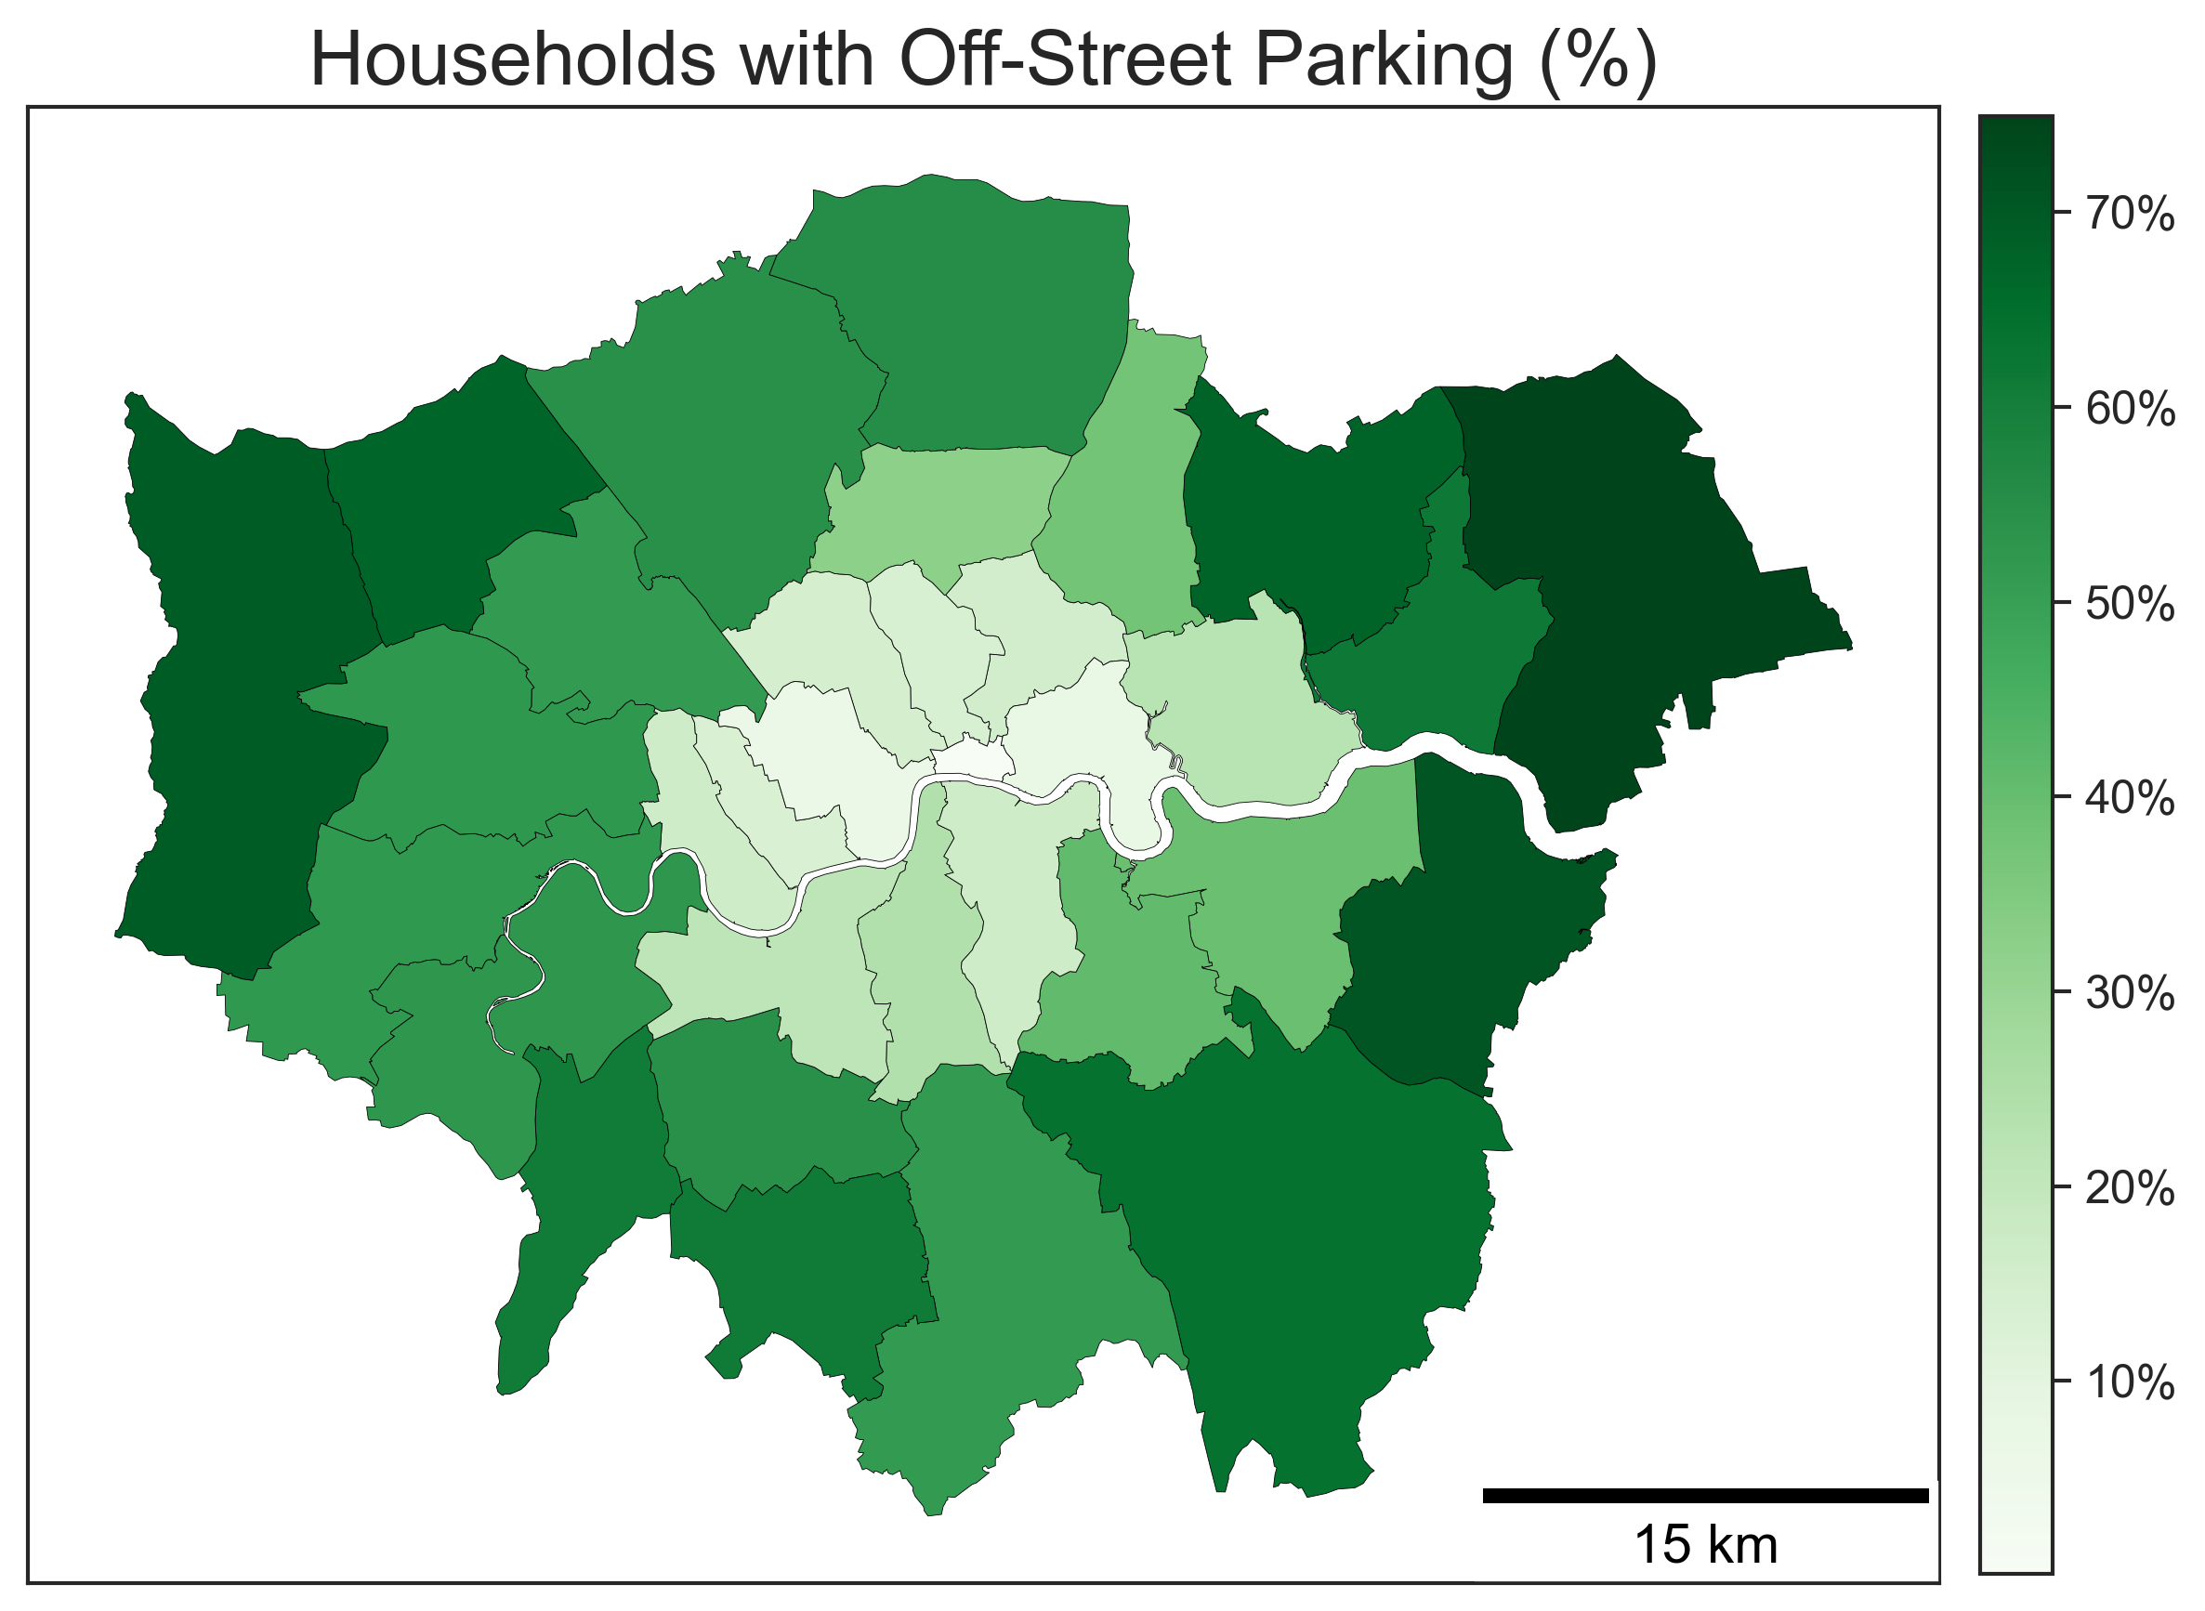
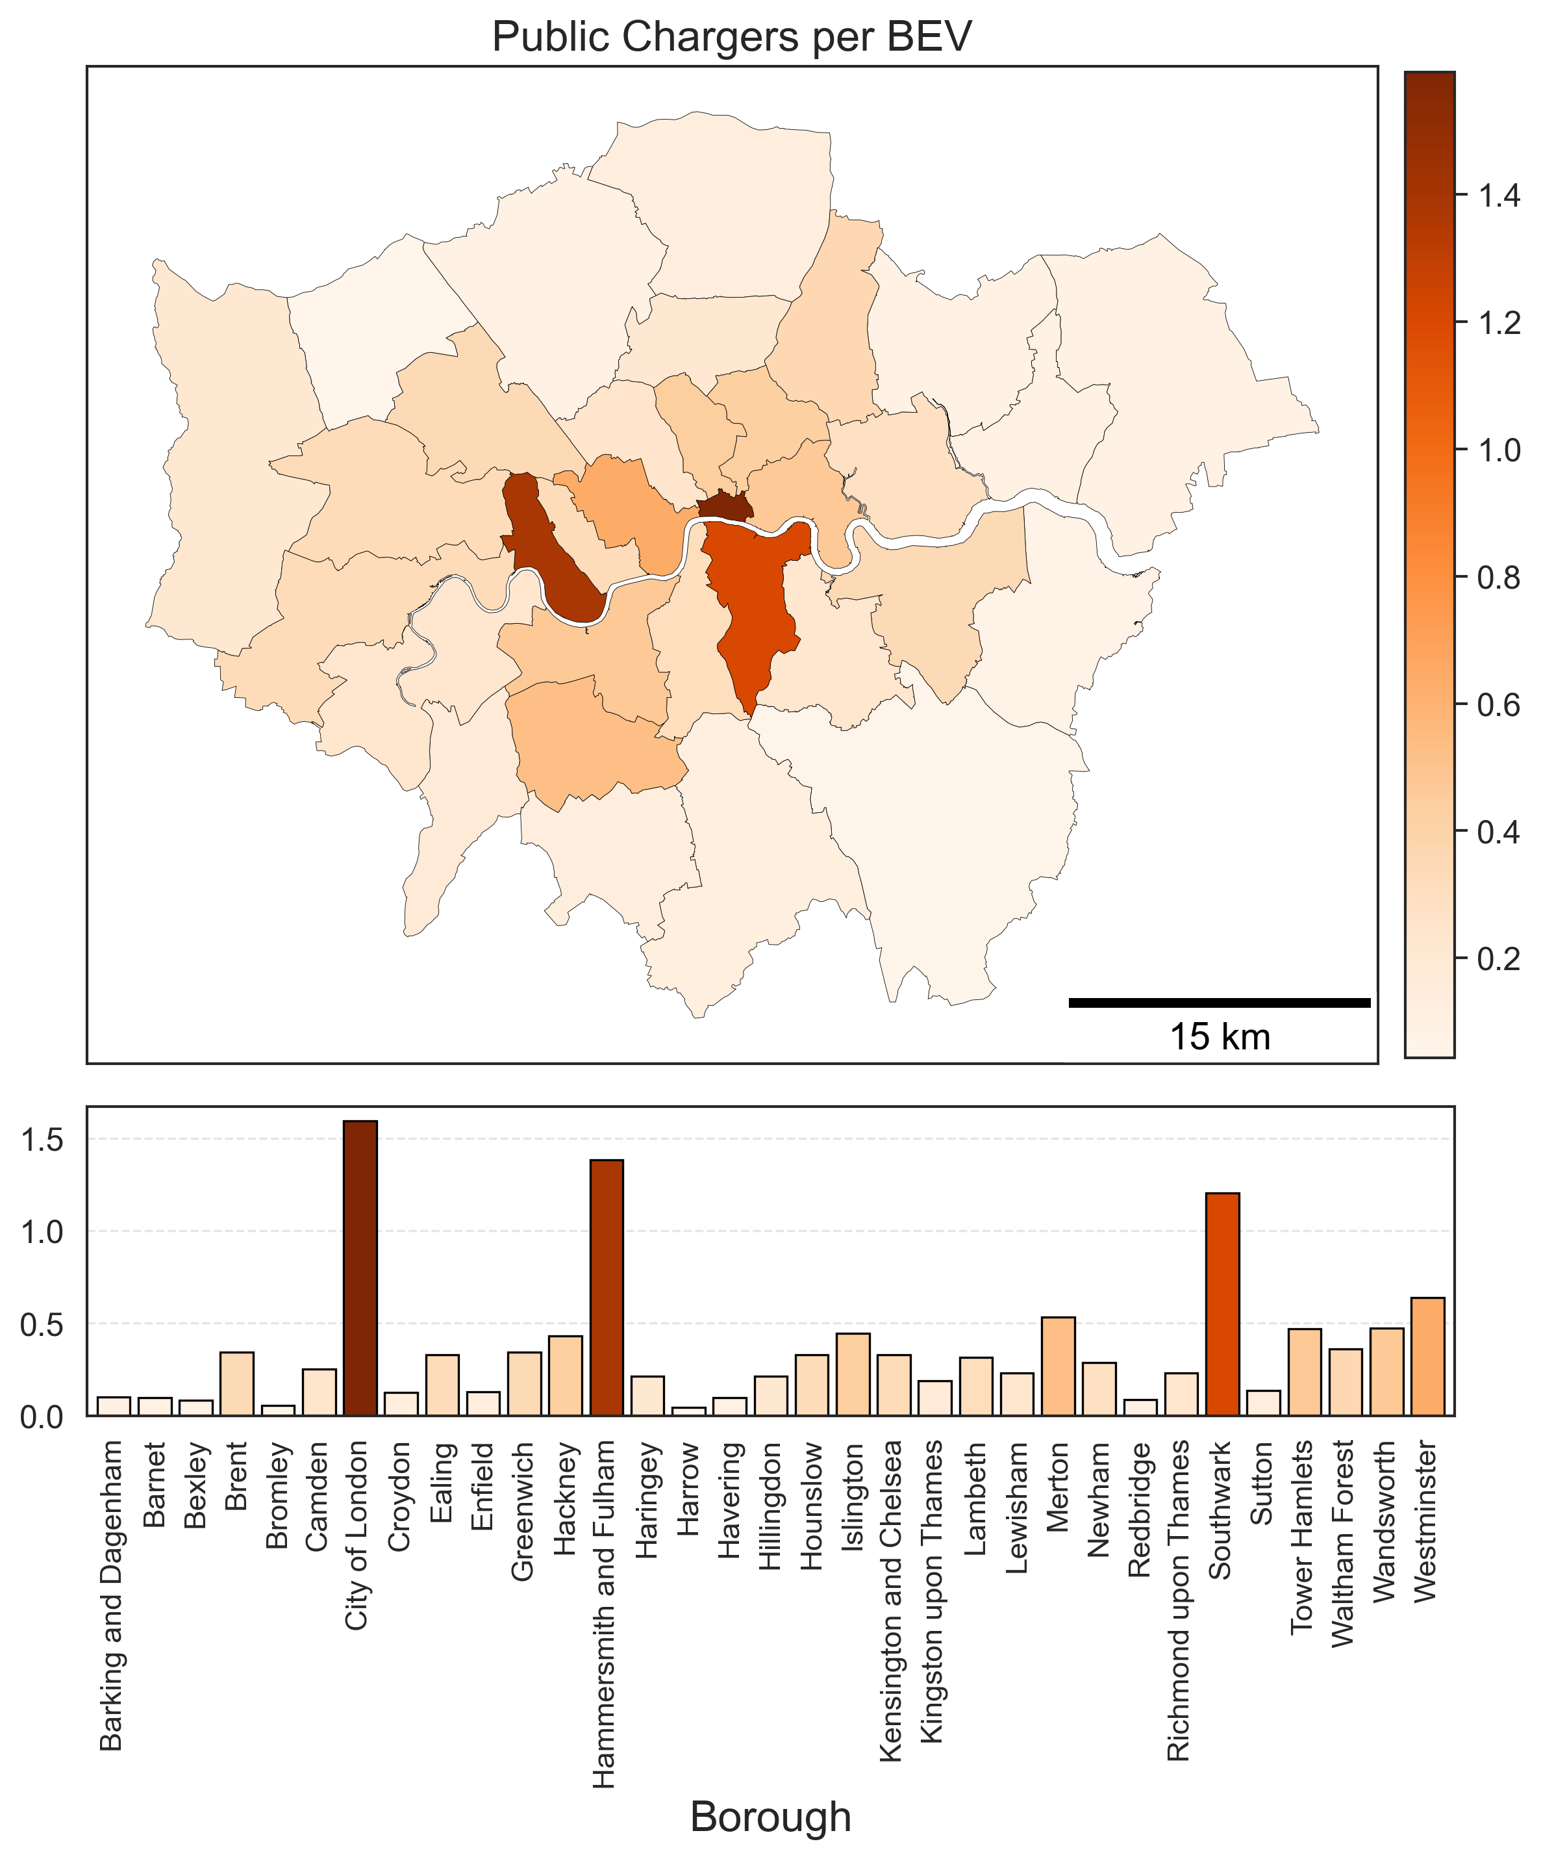
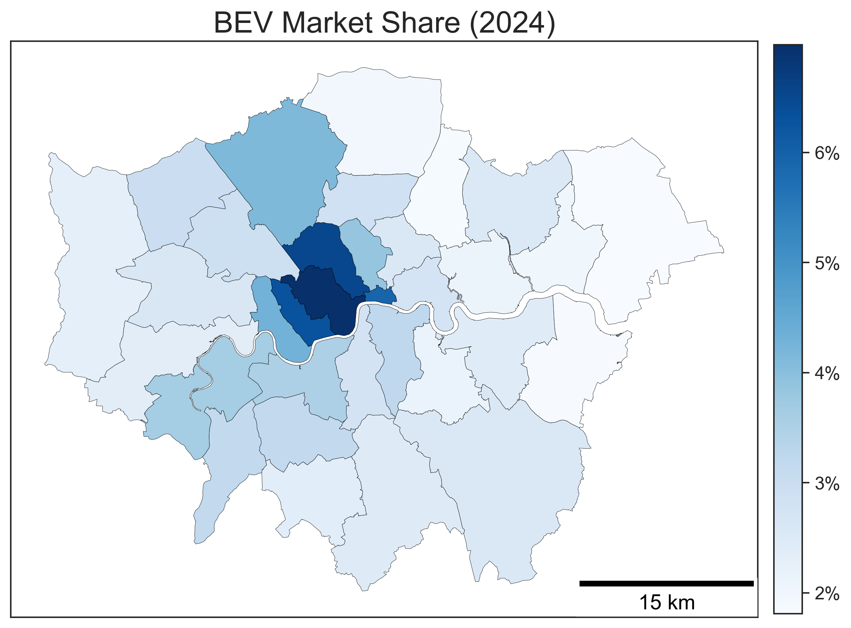
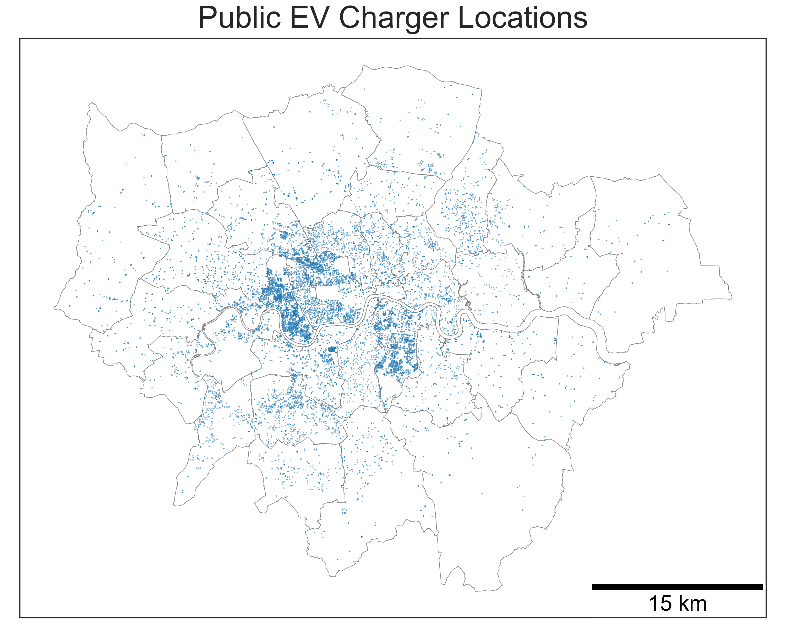
Charging Availability
Early EV adoption driven by affluent households with off-street parking.
Public charger installations are not directly linked to off-street parking availability or EV registrations.
Source: RAC Standing Still Report
Need equal opportunities to charge.
∼ 20,000 Public Chargers in Greater London
Source: OpenChargeMap API
Sources: OpenChargeMap API, Department for Transport

Slide 4
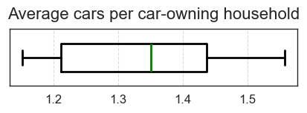
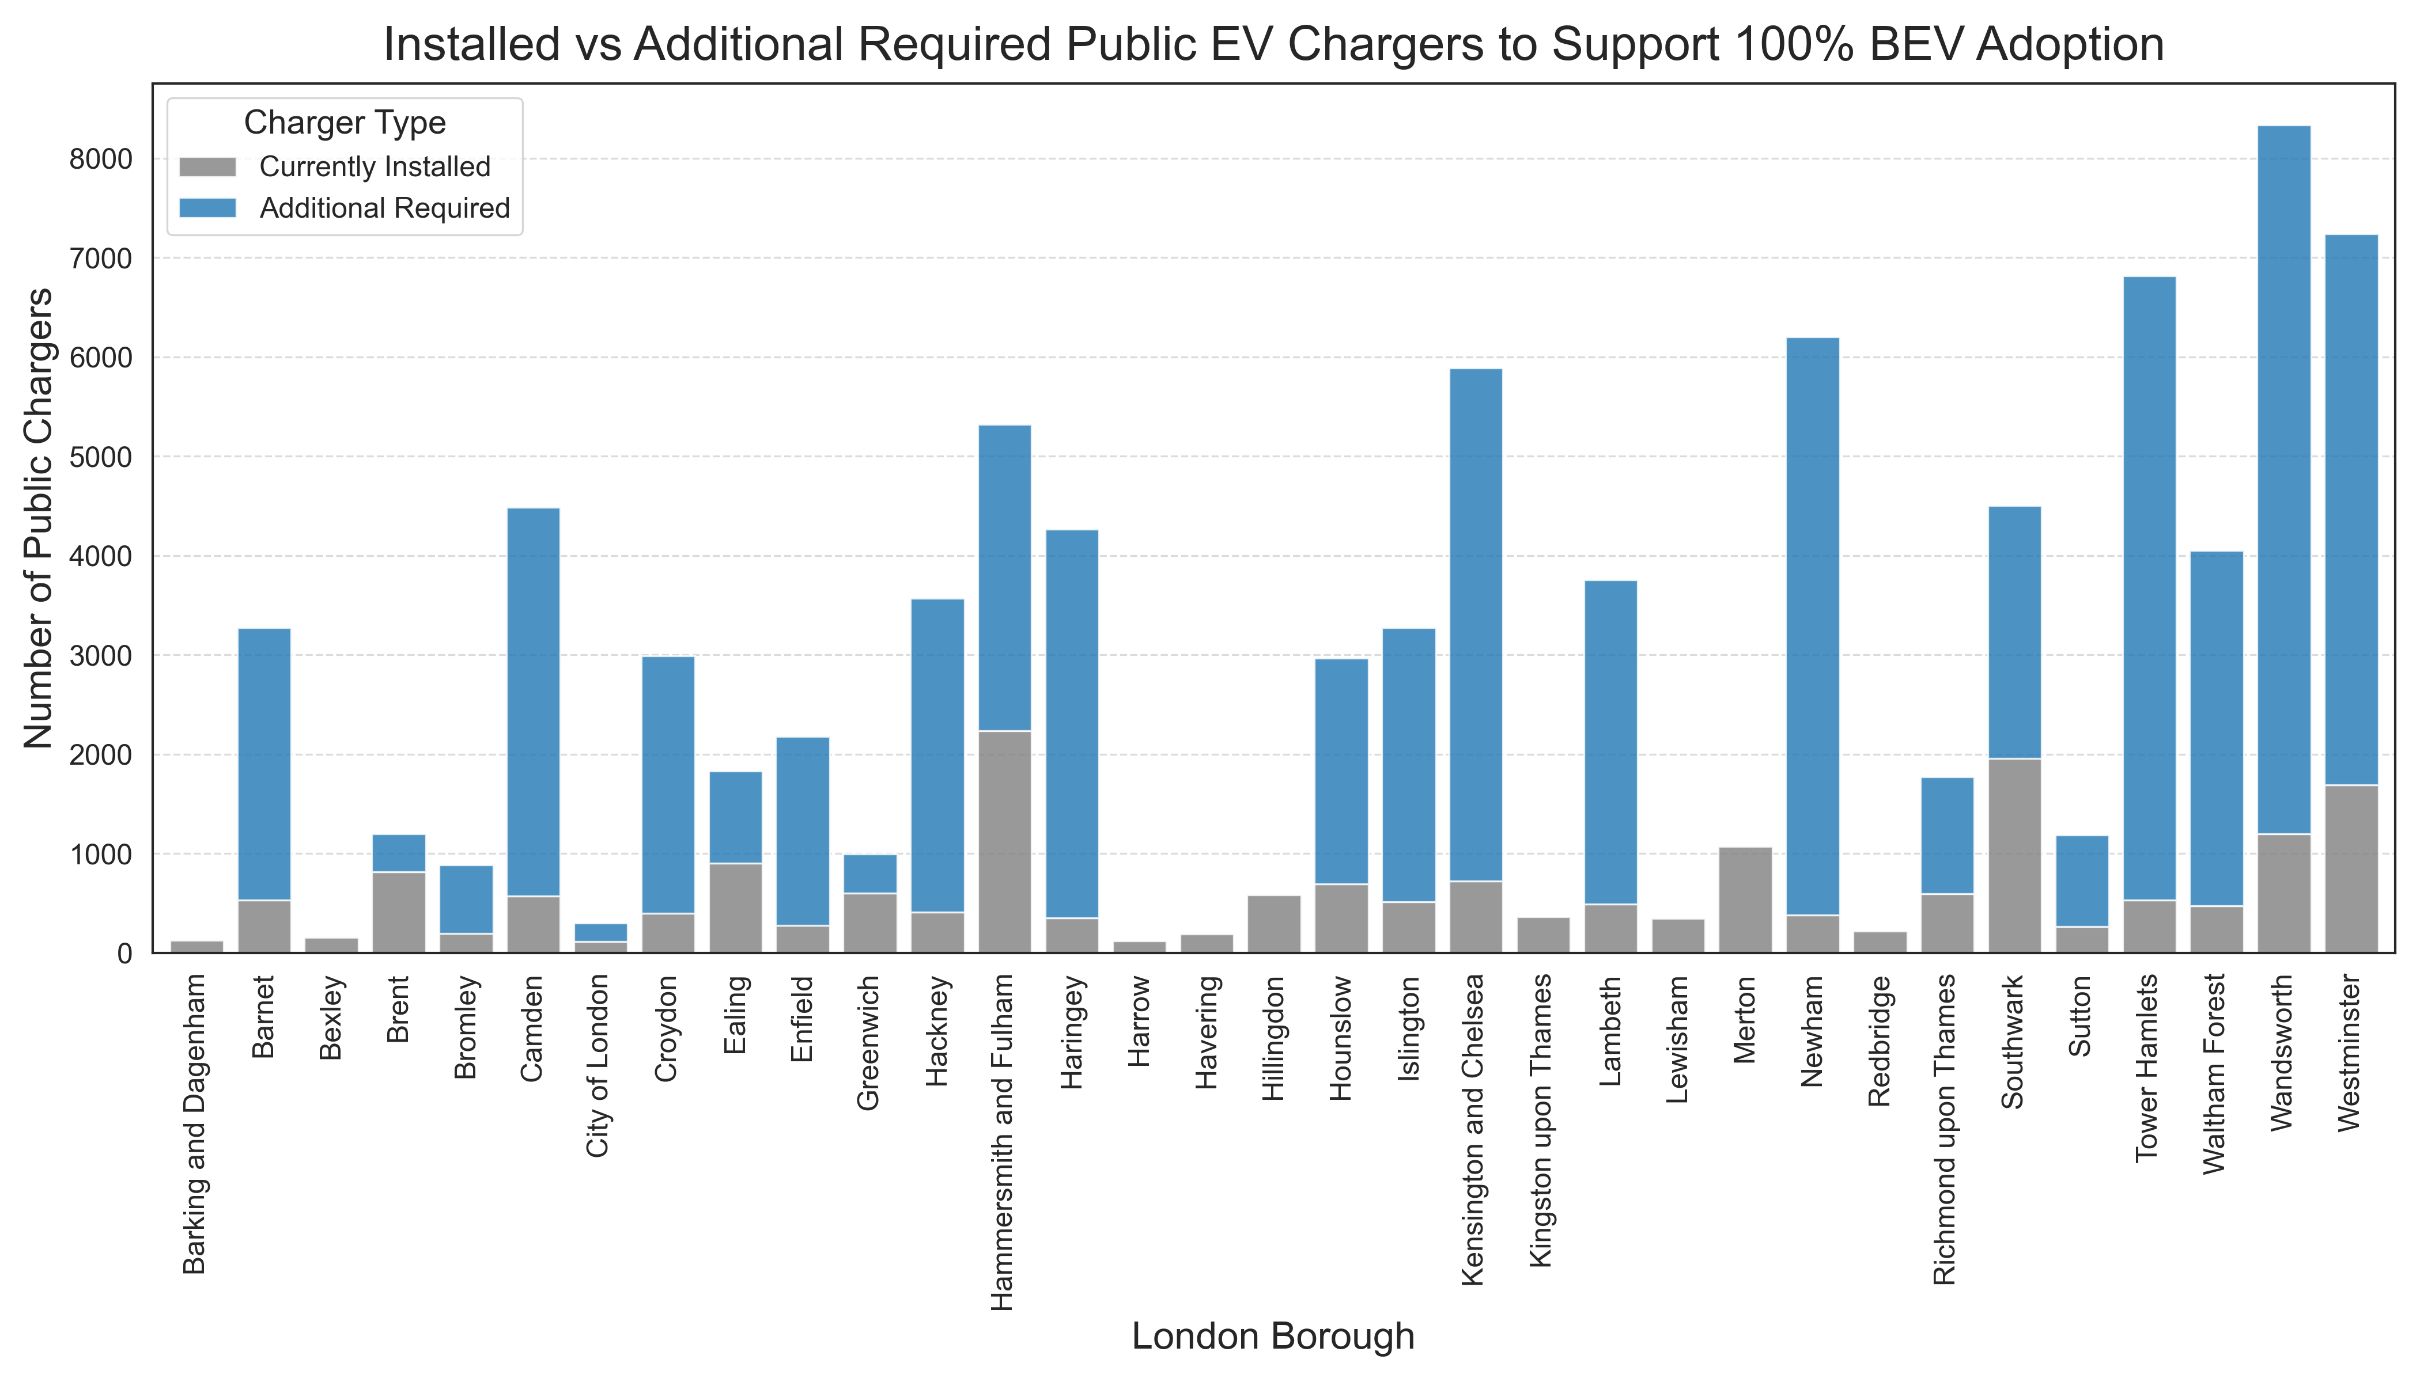
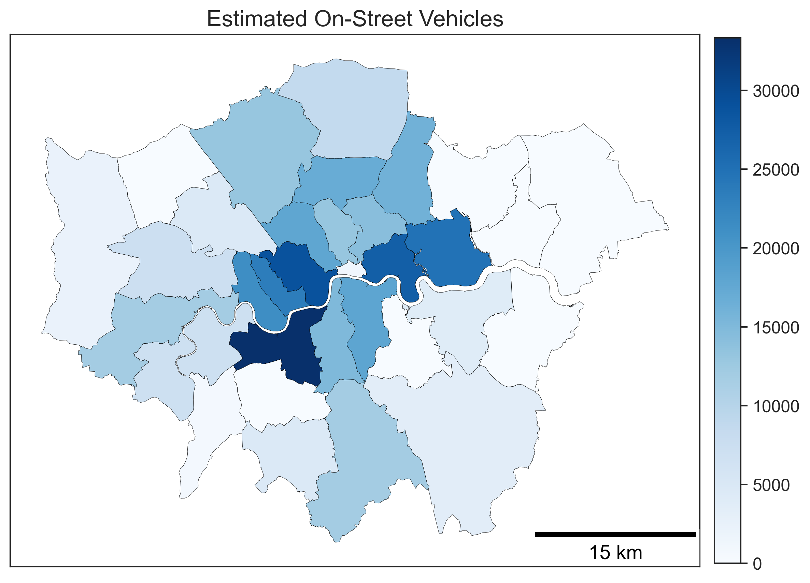
How Many Public Chargers will London Need in the Future?
How many on-street vehicles?
[Assumption: 1.5 cars per off-street parking household]
How many public on-street chargers would be required for 100% BEV Adoption?
[Assumption: Half of the on-street EVs can’t charge via cross-pavement charging]
Source: Census 2021
∼ 70,000 additional public chargers required (up from 20,000)
How many on-street chargers?
(including cross-pavement charging)
[Assumption: 1 charger to every 2 on-street EVs]

Slide 5
Recommendations and Next Steps
Local authorities – Plan for a balanced mix of on-street charging solutions that meet the needs of both inner and outer boroughs. Ensure equitable access to charging to avoid gaps between communities.
Government – Maintain and expand support for on-street charging through funding mechanisms (e.g. Local Electric Vehicle Infrastructure (LEVI) Fund).
Distribution System Operators (DSOs) – EV uptake may rise current low-adoption areas once on-street charging access improves. Early trend detection is crucial for network planning.
Flexibility potential – Consider how the mix of charging solutions will affect opportunities for managed charging and flexibility services.
Data sharing – Improve visibility of EV ownership, charging patterns, and off-street parking availability through better data sharing between government, boroughs, DSOs and local communities to support localised planning.

